Slide 1
Information Proposals and Word Classification
January 13, 2020 Update

Slide 2
Recap / Next Steps
Up until now:
We can receive images
Perform OCR on images
Do processing of extracted OCR
Map list of words to (x,y) locations on image
Using fuzzy matching, map ocr word to highest scoring matched word in master vocabulary
Test out multiple word embeddings
Pubmed
Bio Medical
Wikipedia
…
Get word embeddings from OCR text + top fuzzy matched word
Concatenate word embeddings (as input)
Build word classifier
BioNER
Deep metric learning
Character n-grams
Generate proposals to user
Have user confirm/correct proposals
Do database logic/back end
Produce final output

Slide 3
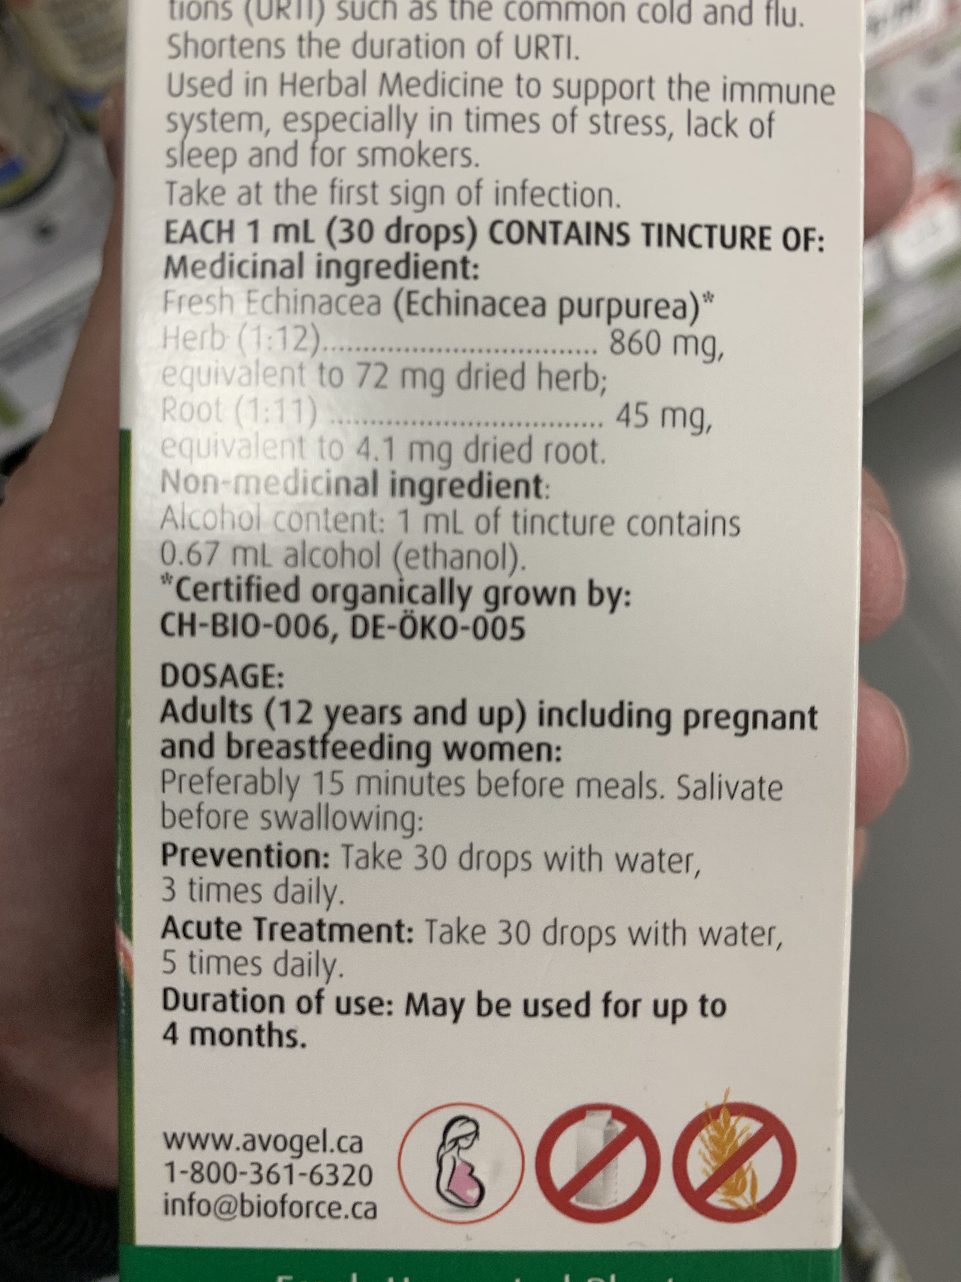

{Relevant Information} Proposals
{‘Echinacea’: [x1,x2,y1,y2], ‘Root’: [x1,x2,y1,y2], ‘Alcohol’: [x1, x2, y1, y2], ‘Dosage’: […], ‘Medicinal’: [..], ….}
OCR Pipeline
Fuzzy Matching + Classification
{‘Echinacea’ : (medicinal-ingredient, [x1,x2,y1,y2]),
‘dosage’: (dose, [x1,x2,y1,y2]),
‘each’: (other, [x1, x2, y1, y2]),
…
‘ocr_word’: (class, [x-y location on image])}
Proposals

Slide 4
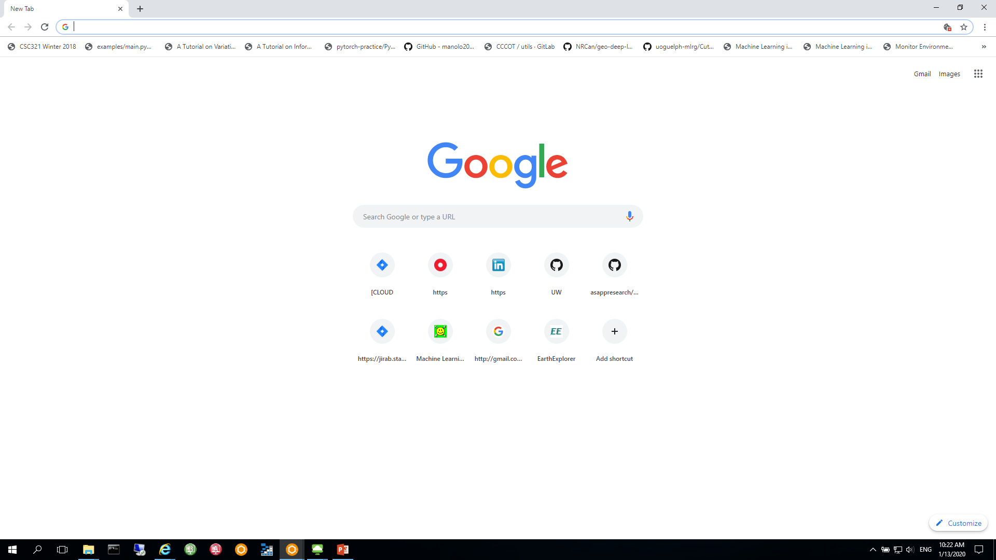

{Relevant Information} Proposals
Extracted:
Medicinal Ingredients
QA
Query the user to confirm extraction
Allows for:
Confirming correct extraction
Spelling correction
Removing unwanted words
Adding missed words
Back-end logic (API calls, NHP assessment, Claims assessment, Compliance assessment)
Final report
Assessments + reasoning
Vitamin a
Vitamin b
Vitamin c
Vitamin d
Add med. Ingredient
Confirm Medicinal Ingredients

Slide 5
Cyclops– Text Classifier + Fuzzy Match
Presenter: Anurag Bejju (Data Science Accelerator)
January 13, 2020

Slide 6
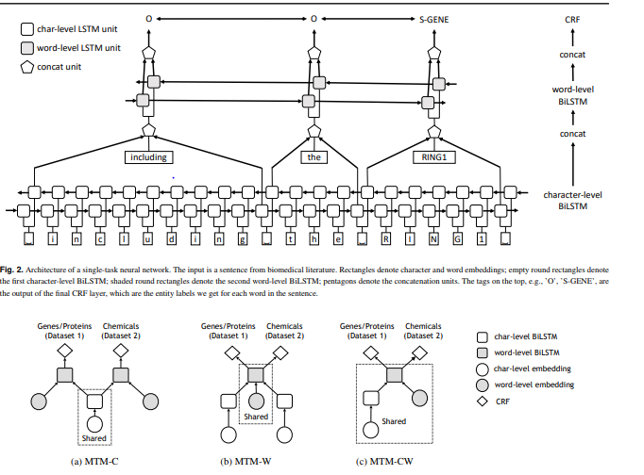
Cross-type Biomedical Named Entity Recognition with Deep Multi-task Learning (Bioinformatics'19)
State-of-the-art Neural network based multi-task learning framework for biomedical named entity recognition
Year: 2019
Developed by: Stanford Uni
Paper: https://arxiv.org/abs/1801.09851
Code: https://github.com/yuzhimanhua/Multi-BioNER

Slide 7
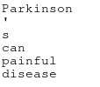
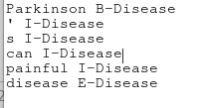
Use Cases tested using pre-trained Model
Use Case 1: Claims detection – Sequencing of words (understand the context)
Training set: Parkinson’s disease
B- Beginning ; I – Intermediate ; E - End

Slide 8
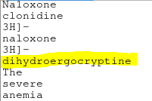
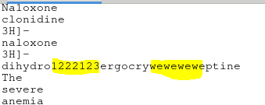
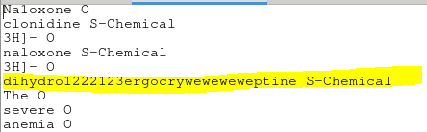
Use Cases tested using pre-trained Model
Use Case 2: Incorrect Spelling – Adding letters
Training set: dihydroergocryptine

Slide 9
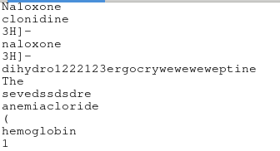
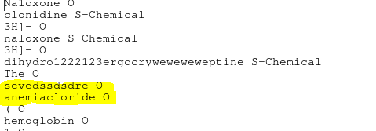
Use Cases tested using pre-trained Model
Use Case 3: Similar sounding words – classified as others
Training set: anemia

Slide 10
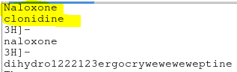
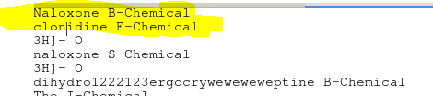
Use Cases tested using pre-trained Model
Use Case 4: Split word
Training set: Naloxone <br> clonidine

Slide 11
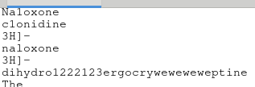
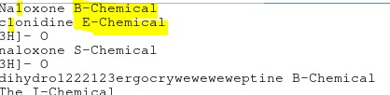
Use Cases tested using pre-trained Model
Use Case 5: Wrong character within word
Training set: Naloxone -> Na1oxone or clonidine -> c1onidine

Slide 12
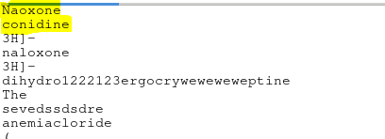
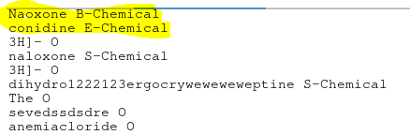
Use Cases tested using pre-trained Model
Use Case 6: Missing character within word
Training set: Naloxone -> Naoxone or clonidine -> conidine

Slide 13
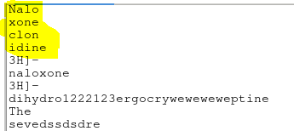
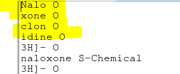
Use Cases tested using pre-trained Model
Use Case 7: Split single word – not classified
Training set: Naloxone -> Nalo <br> xone or clonidine -> clon <br> idine

Slide 14
Annotation Dataset

Slide 15
Annotated Images Stats
Filename | NPN | Claim | Company name
Allmax Arginine Hcl_1.jpg | npn 80026941 | aids in the synthesis of nitric oxide inoj.aides a la synthese de poxyde nitrique ino.stimulates the re leaseofgrowth hormone.stimule la liberation de phormone de croissance.supports the production of creatine.soutient la production de creatine | allmax
Sisu Melatonin_1.jpg | npn: 80000831 | helps increase total sleep time laspect of sleep quality in people.suffering from sleep restriction or altered sleep schedule,.eg shiftwork and jet lag | sisu
Sisu Melatonin_2.jpg | 80027955 | helps increase total sleep time aspect of sleep quality.in people suffering from sleep restriction or altered sleep.schedule, e.g. shift-work and jet lag..aide a augmenter la duree totale de sommeil laspect de melatonin | sisu
NPN | Claim | Company name
npn 80026941 | Non-essential amino acid that is involved in protein synthesis. May help support a modest improvement in exercise capacity in individuals with stable cardiovascular disease | Health Body Services Inc
80000831 | Helps increase the total sleep time (aspect of sleep quality) in people suffering from sleep restriction or altered sleep schedule, e.g. shift-work and jet lag. Helps re-set the body's sleep-wake cycle (aspect of the circadian rhythm). Helps to prevent and/or reduce the effects of jet lag (e.g. daytime fatigue, sleep disturbance) for people travelling by plane easterly across two or more time zones. Helps to reduce the time it takes to fall asleep (sleep onset latency aspect of sleep quality) in people with delayed sleep phase disorder. | SISU Inc.
652 annotated NHP
# with claims: 461
# with product name: 550
# with NPN: 448
# with company name: 510

Slide 16
Thank You /
Je vous remercie

